Slide 1

P peline
The Data
Byte 3
© Jennifer Mankoff & Nikola Banovic
The Data Pipeline; HCII; Spring 2017

Slide 2
Byte 3
Learning Goals:
Explore the value of mobile data
Address data quality issues
Work with location based data
Learn about how to set up a data store in Appspot

Slide 3
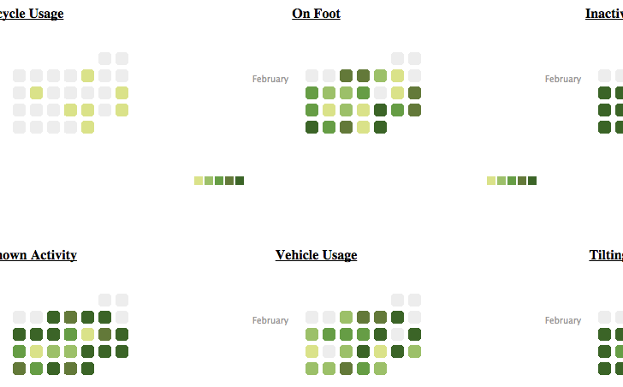
Activities by Time

Slide 4
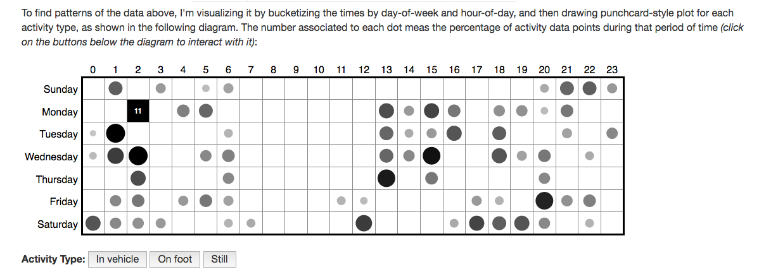
Custom Interactive Viz: Mobility by Time and Day
http://yimmy-mobile.appspot.com/

Slide 5
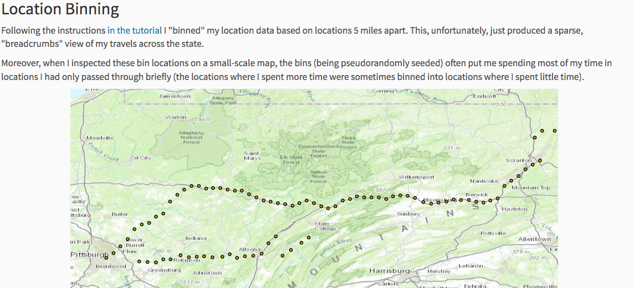
Location Binning
http://mark-where-and-what.appspot.com/

Slide 6
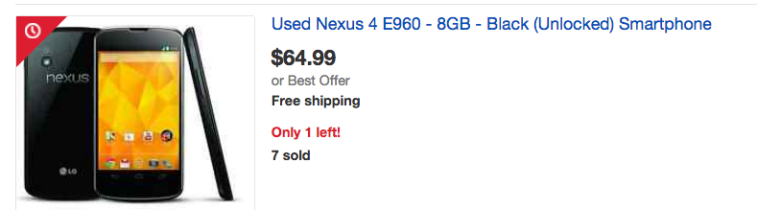
Byte 3 Part 1 (2 weeks)
Your own data; custom visualization
REQUIRED HARDWARE: Android or iPhone

Slide 7

AWARE framework
Dey, Ferreira & Kostakos (Oulu)
Notes:
Install appropriate version using links provided in the assignment.

Slide 8
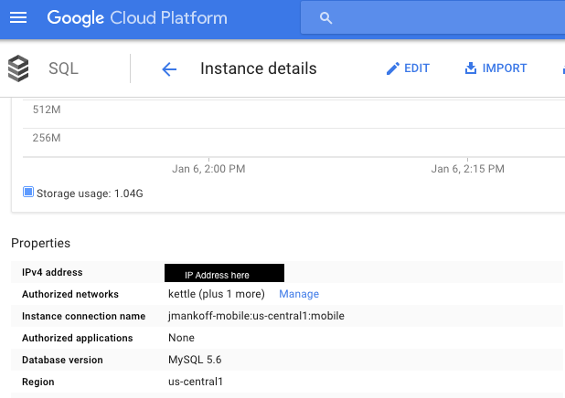
Setting up a Datastore (optional)
Google has great documentation (https://cloud.google.com/appengine/docs/python/cloud-sql/)
You need to customize the access permissions
Cloud Storage
Step 1: Request an IP address from Cloud (‘CloudIP’)

Slide 9
Setting up a Datastore (optional)
Google has great documentation (https://cloud.google.com/appengine/docs/python/cloud-sql/)
You need to customize the access permissions
Cloud Storage: ‘CloudIP’
Step 2: Give access to yourself…

Slide 10
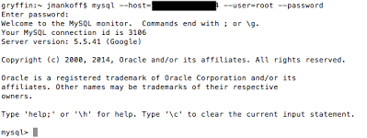
Setting up a Datastore (optional)
Google has great documentation (https://cloud.google.com/appengine/docs/python/cloud-sql/)
You need to customize the access permissions
Cloud Storage: ‘CloudIP’
Step 3: Test your connection to CloudIP

Slide 11
Setting up a Datastore (optional)
Google has great documentation (https://cloud.google.com/appengine/docs/python/cloud-sql/)
You need to customize the access permissions
Cloud Storage: ‘CloudIP’
CREATE USER 'newuser'@’AWAREIP' IDENTIFIED BY 'password'; GRANT ALL PRIVILEGES ON byte4.* TO 'newuser'@’AWAREIP';
Step 4: Use that connection to set up further permissions for AWARE

Slide 12
Loading the data
Mysql --host [ip] --user=[user] --password=[password] [database] < [file.sql]
[ip]: The IP of your cloud database
[user]: The username you created for your cloud database
[password]: The password you created for your username
[database]: The database the data should be imported to [file.sql]: The name of the sql file to import

Slide 13
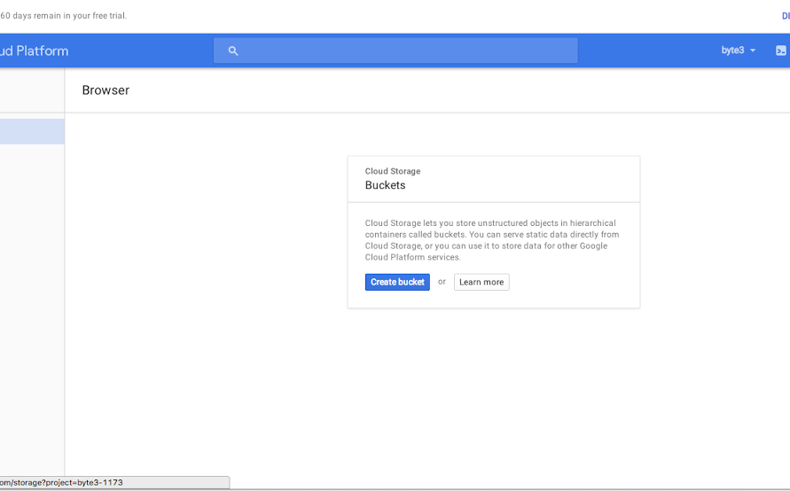
Or use a GUI

Slide 14
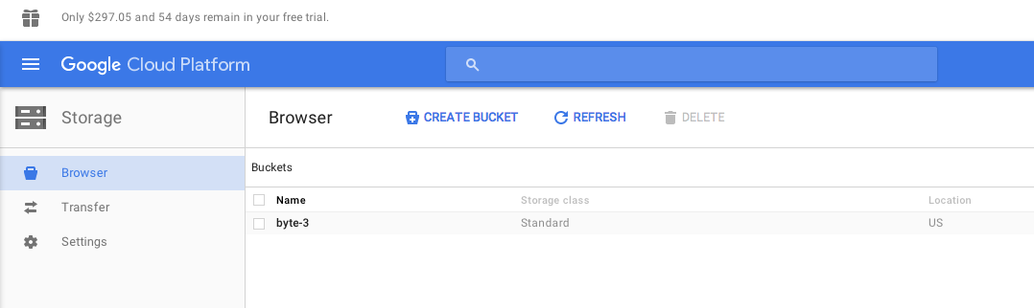
Create a bucket (byte3 here)

Slide 15
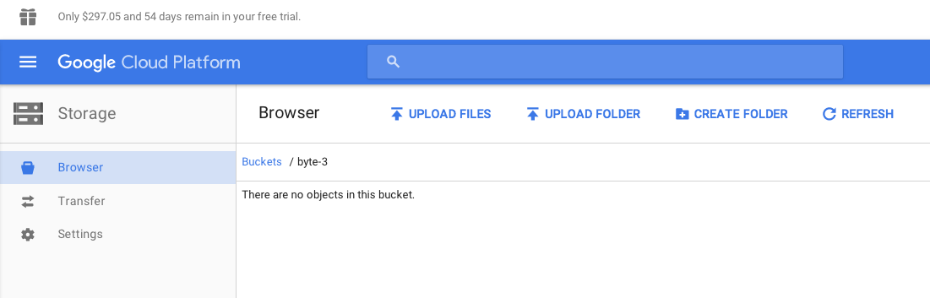
Upload the sql dump file

Slide 16
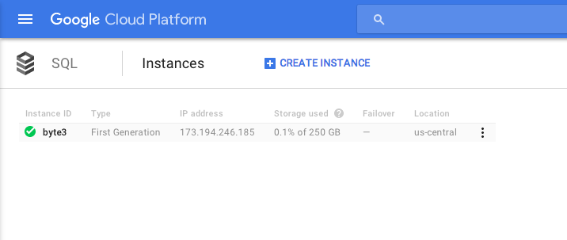
Now click on byte3

Slide 17
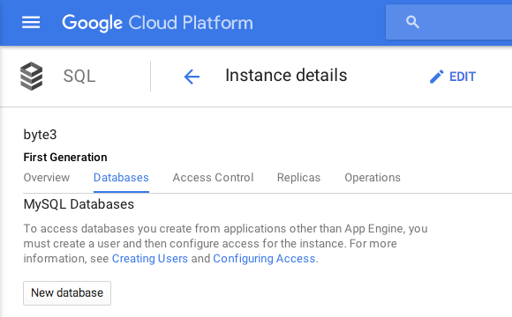
Create a database in it

Slide 18
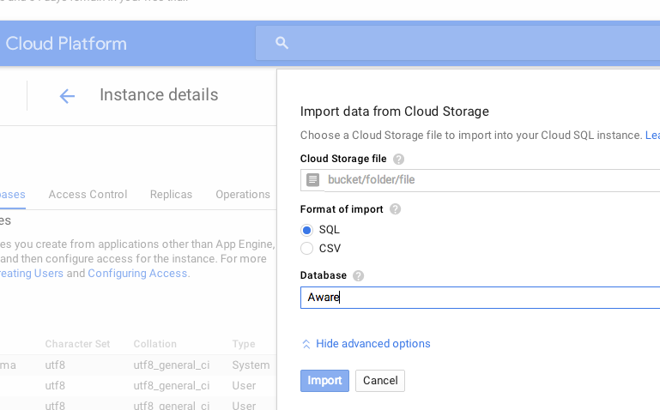
Create a database in it

Slide 19
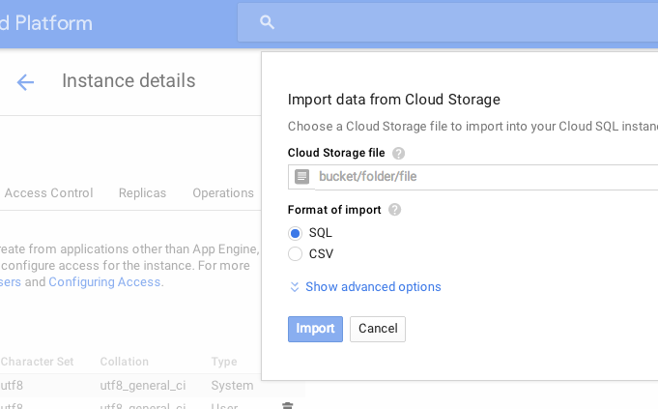
Import your data

Slide 20
Accessing MySQL from python
db = MySQLdb.connect(unix_socket='/cloudsql/' + _INSTANCE_NAME, db=_DB, user='root')
cursor = db.cursor()
Helper function – prints result to log
self.make_and_print_query(cursor, 'SHOW TABLES', 'Show the names of all tables')
Helper function – returns result as list
rows = self.make_query(cursor, query)

Slide 21
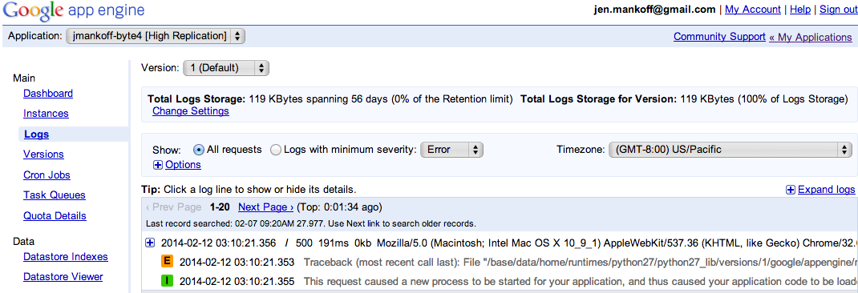
Debugging this assignment
Server side debugging is a bit of a pain
Google helps though – provides access to logs

Slide 22
More Debugging
My helper function prints recent SQL commands to log and catches SQL query errors
You may also see errors show up in the [projectname]-byte4 browser window

Slide 23
What do can need to do with mobile data?
Cleaning: can you tell when the phone is off? (not a focus of this byte)
Organizing: identifying common locations (what the byte walks you through)
Associating: connecting activities to other context (we explore location + activity, homework is to explore time + activity)

Slide 24
Basic Hand In Expectations
Improve the location binning by picking a better epsilon
Explore relationship between time and activity (your main job on this assignment)
Display the results (more nicely than I do!)

Slide 25
Advanced Hand In Expectations
You could design a study that looks at something besides activity
Talk to me about goals & outcomes that make sense

